Slide 1
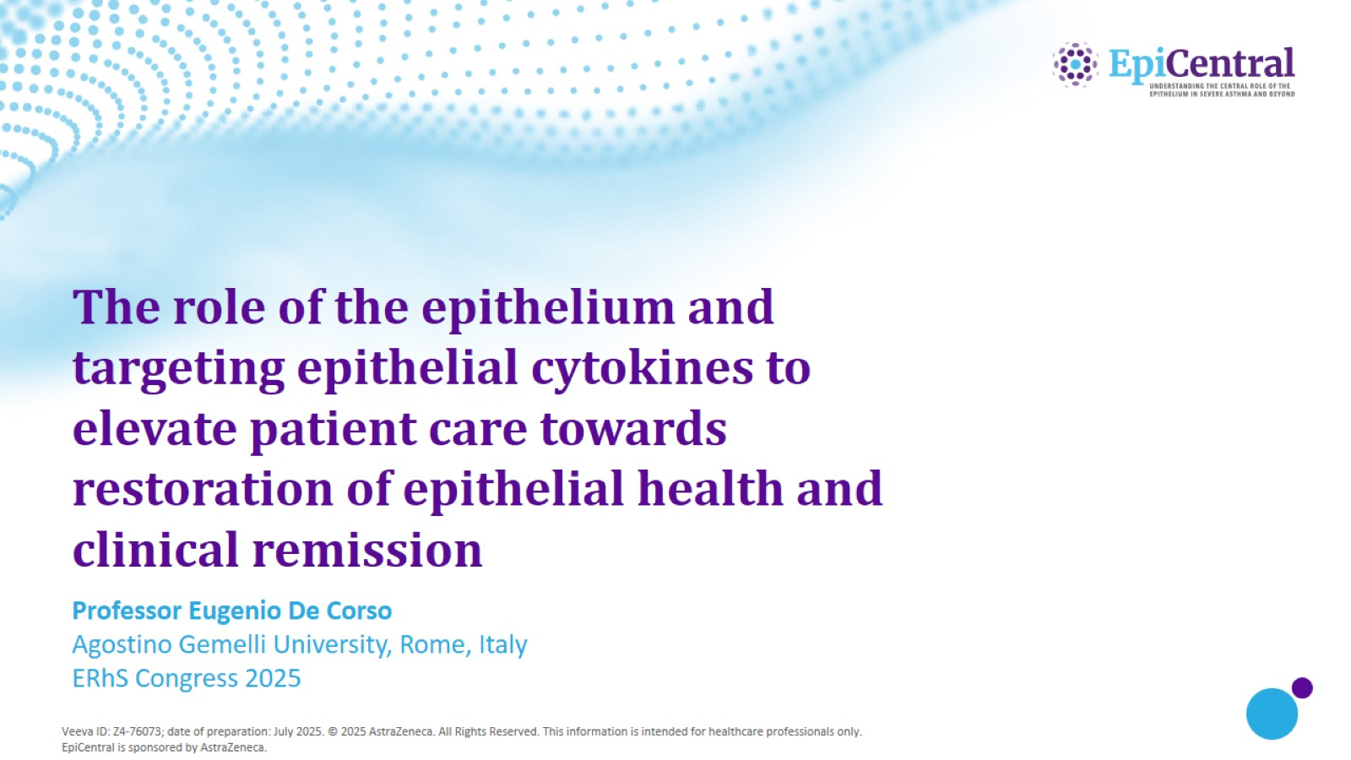
The role of the epithelium and targeting epithelial cytokines to elevate patient care towards restoration of epithelial health and clinical remission

Slide 2
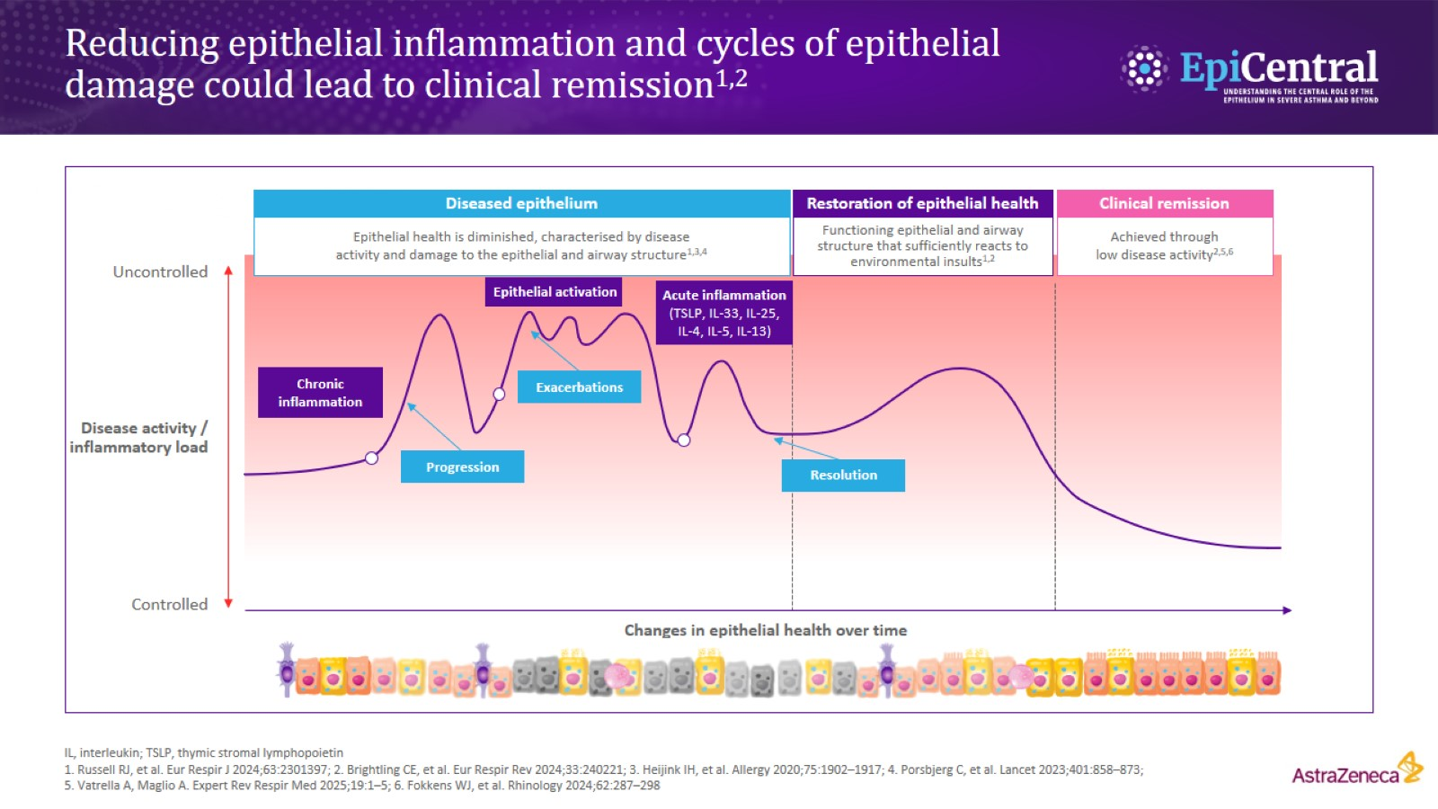
Reducing epithelial inflammation and cycles of epithelial damage could lead to clinical remission^{1,2}

Slide 3
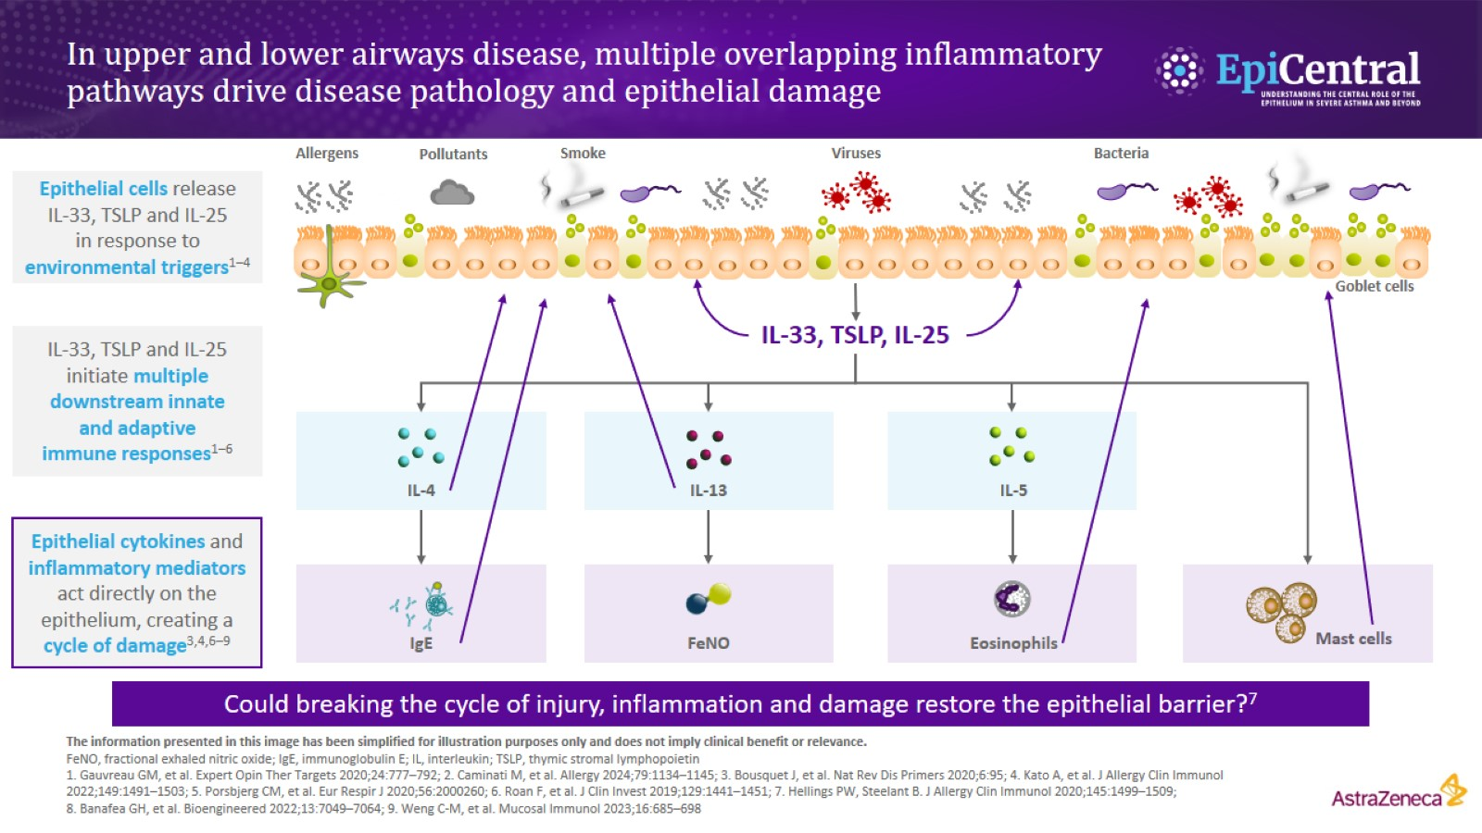
In upper and lower airways disease, multiple overlapping inflammatory pathways drive disease pathology and epithelial damage

Slide 4
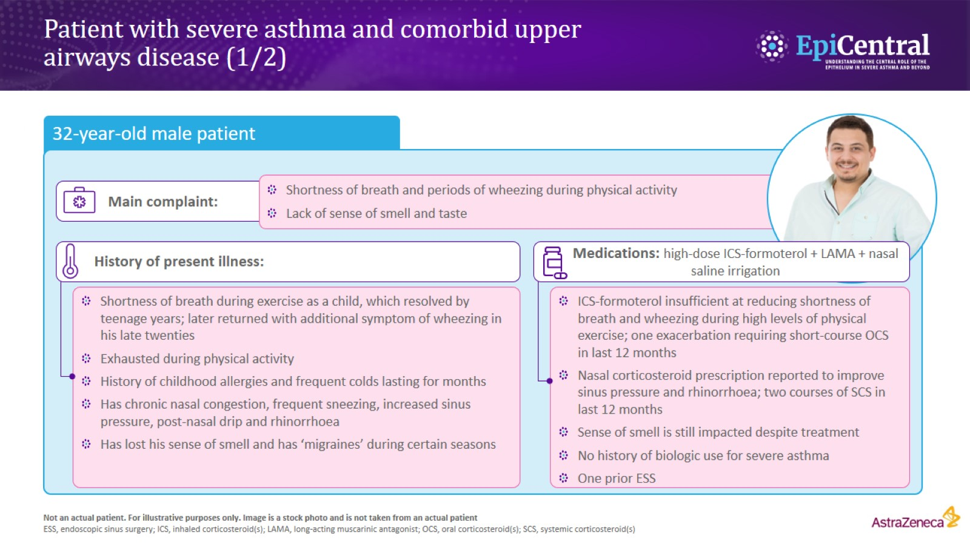
Patient with severe asthma and comorbid upper airways disease (1/2)

Slide 5
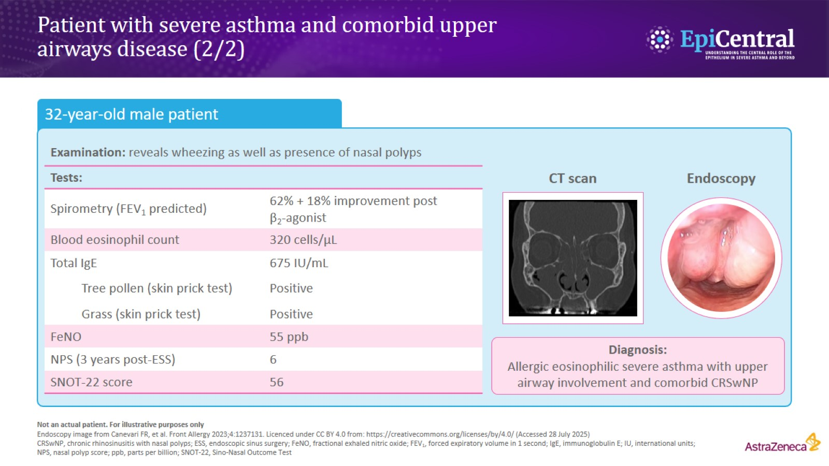
Patient with severe asthma and comorbid upper airways disease (2/2)

